Slide 1
Automaton Theories of Human Sentence Comprehension - Ch. 3: Generalized Left-Corner Parsing
2020. 01. 09
Won Ik Cho
Notes:
.

Slide 2
Pushdown Automaton and CFG
Question: How can we combine ‘time’ with a generative grammar?
This yields a concept of ‘automaton’
Mathematical model of computation
Pushdown automaton and a CFG?
Each operation in the automaton corresponds to a particular CFG rule
“Strong competence” or “Transparency”
Desirable property in an algorithmic model
Clarify the relationship between Marr’s level
Transparent processor
The causal actions do what the grammar specifies
No canonical automaton for a given grammar
Generalized left-corner parsing: a theory of one aspect of control
A case of Kowalski’s (1979) slogan: ALGORITHM = LOGIC + CONTROL

Slide 3
Automaton and Functionalism
Basic idea of automaton:
Differentiate abstract ‘states’ from one another,
and specify what happens to cause transitions between them
A simple automaton
Each node: States
Arcs between: Vocabulary
Path: Sentence
Automaton recognize a sentence ⬄ Path exists?
Automata as cognitive models ⬄ Functionalism (Putnam, 1960)
Minds as a software of the brain
What’s important is what states can do (rather than ingredient)
Possibly a ‘relativism’?
What current NNs (neural networks) share?

Slide 4
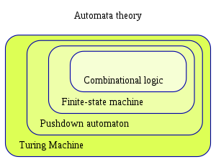
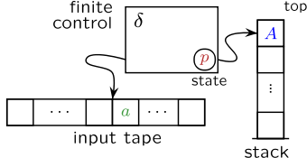
Pushdown Automata
Finite automata with a stack memory? → Infinite-state machines
e.g., Keep track of embedding levels (garden-pathing)
How PDA does this? → A recursive transition network
Pushing the stack whenever it begins an embedded sentence
Popping the stack whenever it finishes one
Key difference between FA
Special ‘PUSH’ that transfers control to another network of circles and arrows
Elements are distinguishable arbitrary symbols
https://en.wikipedia.org/wiki/Pushdown_automaton

Slide 5
Top-Down Parsing
Goes through a series of transitions that mimic the line-by-line derivation
Two main operations
Expand: Replace the stack symbol with the sequence of symbols
Scan: Remove the terminal symbol from both the stack and the input
Three general points to be illustrated:
Incrementality
Deals with each word one-by-one, L to R, via ‘scan’
Strong Competence
Each grammar rule gets its own operation
Nondeterminism
Fails to specify exactly which operation should apply when more than one step is applicable

Slide 6
Bottom-Up Parsing
Write the grammatical category and then find possible rules
Two main operations
Reduce: Replace a sequence of symbols with a stack symbol
Shift: Push the terminal word on the top of the stack symbolizing it
Delay – a Hallmark of bottom-up parsing
e.g., Subject NP is not combined with its VP until the internal structure of the VP is fully recognized
Nondeterminism: Not reduced
Various candidates of reduction
Reduce/reduce conflict
The choice between reducing and simply going onto the next word
Shift/reduce conflict
What is the cost of remembering?
Contrastive patterns of memory consumption

Slide 7
Left-Corner Parsing
Resnik: Neither of the two parsing strategies match human performance
Right-branching and left-branching both available?
Left-Corner Parsing
Combining good points of both strategy
From Bottom-up: Evidence must first be found before a rule can be used
From Top-down: Satisfied with only a limited amount of evidence
Two main operations incorporating nondeterminism
Project: Replace symbol with a record and an expectation
Project + Complete: Replace symbol and expectation with the new EXP
Shift: If next word is a terminal symbol, the push it on the top of the stack
Fits English very well, but how about other languages?

Slide 8
Generalized Left-Corner
Even English has phrases that aren’t head-initial
e.g., John loves Mary passionately
Attaching adverbial post-modifier
‘passionately’ not wanted by any lexical property of the head of the VP
Optionality makes no sense to project on the basis of some left-corner
GLC: one way to mix traversal orders
Each rule receives an annotation on its RHS: Announce point
LHS substrings constitutes the ‘trigger’ of this particular rule
Putting announce point at the end of adjunction rules allows modifiers to be parsed bottom-up, without unmotivated anticipation
GLC parsing allows a theorist to systematically vary the degree to which parsing is predictive on a per-rule basis
Every hypothesis about degree-of-expectation can be formalized as a particular positioning of the announce points

Slide 9
Thank you!
EndOfPresentation

